Slide 1
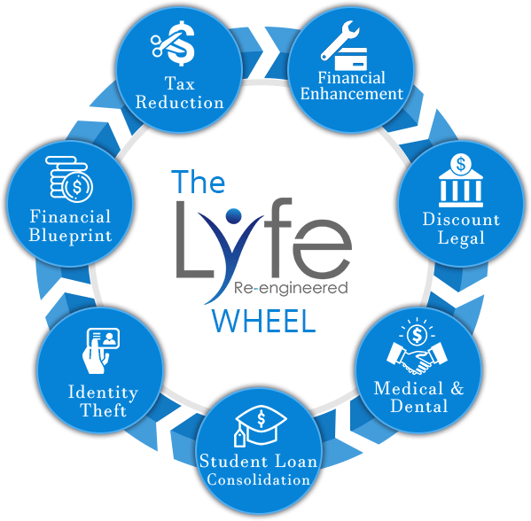

Slide 2
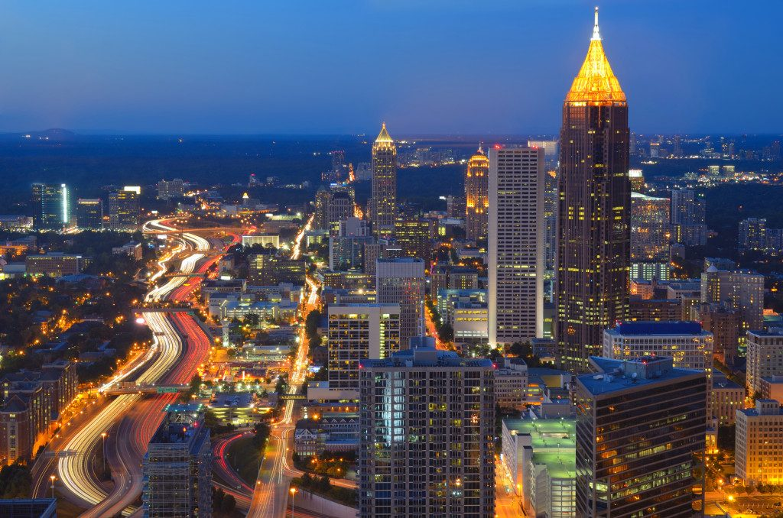
Welcome to Lyfe
______________________________________________________________________
We are a Debt free marketing company based in Atlanta, GA
Licensed Funding Advisors
Certified Business Credit Coaches
Credit counselors
Attorney’s
CPA”s
Business Consultants
www.LyfeReengineered.com
Notes:
2

Slide 3
For Individuals
www.LyfeReengineered.com

Slide 4
Credit Restoration
AAA Credit Today
In business since 2008
We cover the entire 50 states
403,568 Negative Items Deleted
360 Million in Inaccurate Debt Deleted
11,345 Customers Served
129 Average Point Increase
www.AAACreditToday.com

Slide 5
Credit Impacts Everything
Military Service
Credit Card Interest Rates
Loss of Wealth
Employment/Promotions
Automobile & Insurance
Interest Rates
Owning or Renting

Slide 6
How We Do It
We have a team of Attorney’s, CPA’s and trained professionals
We use the Fair Credit Reporting Act to protect and restore your credit
We ensure that your credit file is free of errors, erroneous and misleading information
We ensure that all laws and federal guidelines were followed correctly during the reporting process.
www.LyfeReengineered.com

Slide 7
4 Simple Steps
EACH NEW CLIENT RECEIVES
Free Analysis
Customized Game Plan
FREE Credit Report Dispute Summary
MONITOR
Monitor progress 24/7
Text & Email Alerts
Personalized Dashboard
Unlimited Disputes
Bankruptcy
Foreclosure
Late Payments
Excessive Inquiries
Public Records
Judgments
Collections
Reporting Errors
Repossessions
Credit Fraud
Identity Theft
Charge-Offs
Better Interest Rates
Better Job Opportunities
Credit Card Approvals
Auto Financing
Buy Your Dream Home
www.LyfeReengineered.com

Slide 8
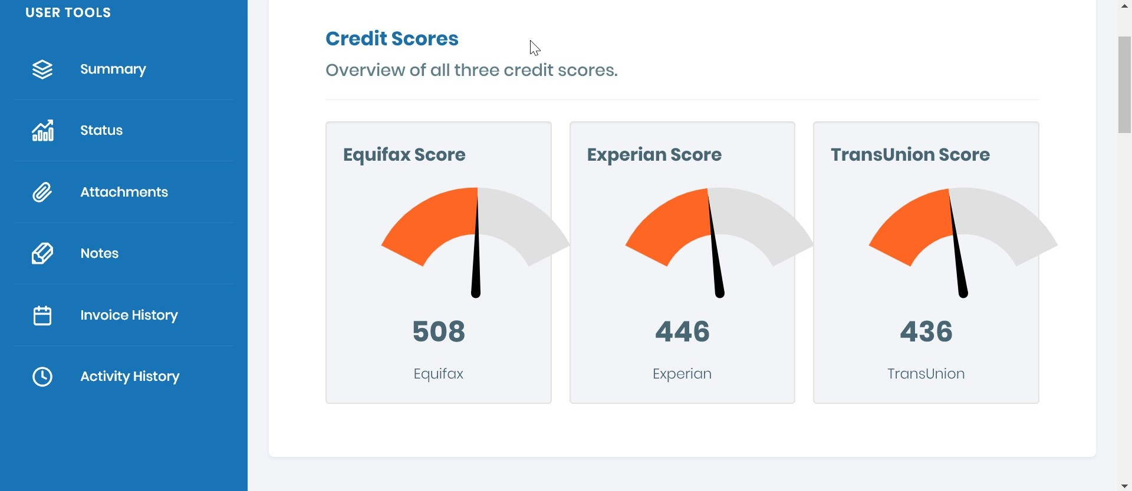
Customer Portal

Slide 9
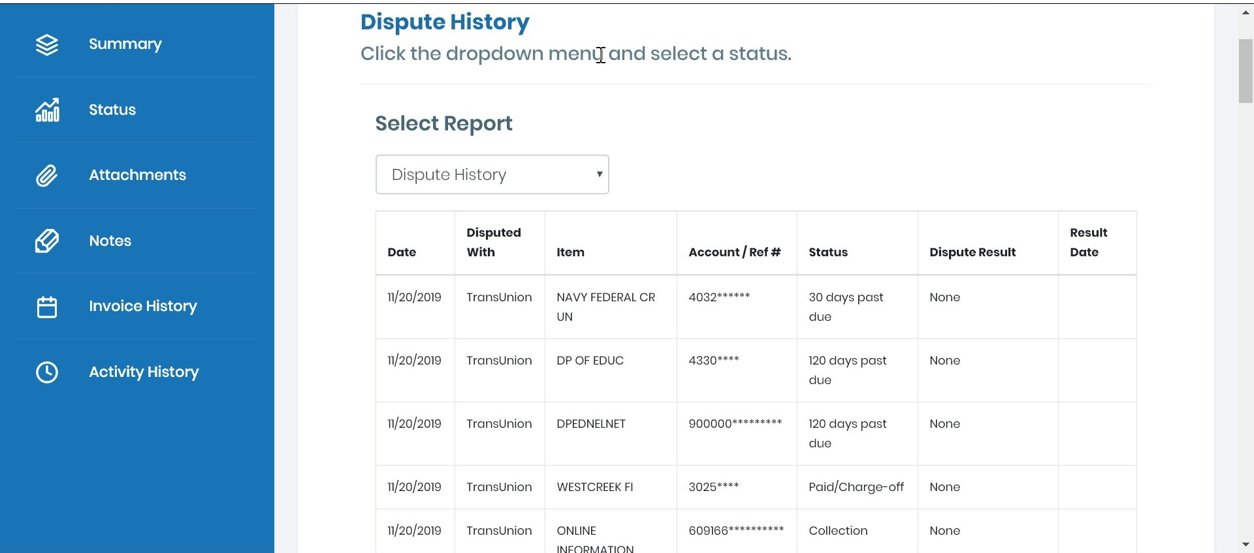
Real Time Updates

Slide 10
How Do We Differ?
We provide a comprehensive credit restoration consultation
We won’t deliberately drag out the process
We don’t do “Clean Sweeps”
We won’t ask you to print and mail your letters
We provide 24/7 customer access to see our work in “real time”
www.LyfeReengineered.com

Slide 11
Simple, Easy to Afford, No RISK Pricing
IF WE DON’T DELETE... | YOU DON’T PAY!!!
Initial Audit/Processing Fee | $199
Inquiries | $10
Technical Data | $15
Standard Deletions | $40
Judgments/Bankruptcies/Tax liens | $250
If we don’t delete/repair a minimum of $199 in negative items, you’ll take your next vacation on us!!! You will receive a FREE 3 day/ 2 night vacation get-a-way!!
The max you will pay in any round is $150/month

Slide 12
For Business Owners
www.LyfeReengineered.com

Slide 13
Business Credit & Funding Platform
www.LyfeReengineered.com

Slide 14
Business Credit & Funding Platform
_____________________________________________________________________
Free DUNS number
Free Experian Smart Business report
Loans from $5,000 to $25,000,000
The Largest Supply of Business Credit Sources Anywhere
400 Direct Lenders
2,100 Lending Options
30 Core funding Products
25,000 Funding Programs
$50,000 Guarantee
1 Year Business Credit Coach
5 Year Licensed Funding Advisor
State of the Art Software
Credible, Fundable, Compliant: today’s Lending Standards

Slide 15
Value Proposition
Additional Features/Benefits | Value
Free Duns Number & Experian Smart Business Access | $1,000
One Year access to Certified Business Credit Coaches | $1,000
Five Years access to Licensed Funding Advisors | $2,500
$50,000 GUARANTEE | $50,000!!!
 | Total Value = $54,500

Slide 16
Personal Funding
www.LyfeReengineered.com

Slide 17
Personal Funding
We can help clients gain access to low introductory rates for credit cards and/or lines of credit using their personal credit saving you thousands!!!.
Approvals in 2 Days & Funding in 7 Days.
Our average customer receives $25,000 in personal funding.
NO upfront fees
5% - 10% Success Fee
If we can’t get you funding you’ll
get a FREE 3 dat 2 night “get-a-way”
www.LyfeReengineered.com
Notes:
17

Slide 18
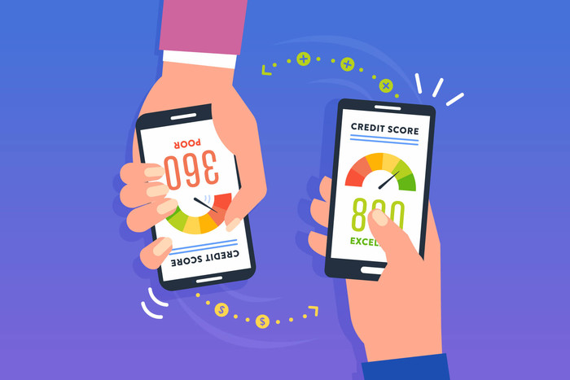
Credit Score Boost
What is an Authorized user?
It allows the authorized user to have the primary account holder’s credit history show up on his/her credit report.
This can be a tremendous benefit for anyone who is having trouble building a credit history on their own.
Strategy has been around many years to help jump start the credit enhancement process.

Slide 19
Credit Score Boost
Case Study #1: Client had original scores of mid 500’s and scores increased to 800+ in 45 days!!
Case Study #2: Client did not have enough data to generate a score, and after adding a couple of tradelines, his score increased to 750+ in just 40 days!!
Case Study #3: Client’s scores increased from the low 600’s to the low 700’s in less than 30 days!!

Slide 20
Debt Elimination

Slide 21
Dental, Health, Telemedicine
www.LyfeReengineered.com

Slide 22
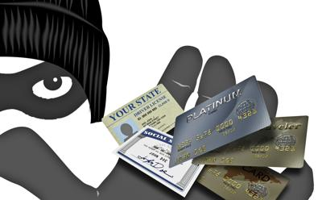
Identity Theft
www.LyfeReengineered.com

Slide 23
Student Loan Consolidation
www.LyfeReengineered.com

Slide 24
Legal Services
www.LyfeReengineered.com

Slide 25
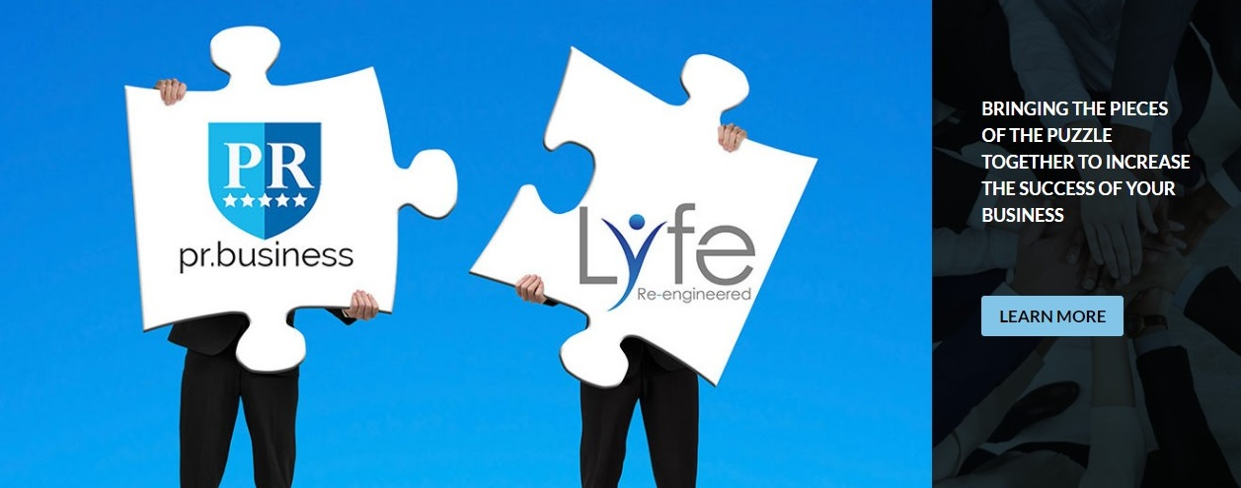
Digital Marketing Services
www.YourNewLyfe.com

Slide 26
Incorporation Services
www.YLyfeReengineered.com

Slide 27
Merchant Processing
www.LyfeReengineered.com

Slide 28
The Lyfe APP
______________________________________________________________________
Notes:
28

Slide 29
Home Based Business
www.LyfeReengineered.com

